Slide 1

Software Quality Assurance – Project Presentation Find Corona
Shivam Joshi (2781474)
NeelKumar Sheladia (2786608)
This Photo by Unknown Author is licensed under CC BY-SA

Slide 2
Why software testing? (Importance)
Introduction to “Find Corona” application
Technology used
Test design
Test case Specification
Test results
Conclusion

Slide 3
Why Software Testing?
Requirements/Design Review
Test Planning
Identify the correctness, completeness and quality of developed computer software.
Activity to check if software system is defect free.
Various stages of software testing life cycle.
Test Designing
Test Environment Setup
Test Execution
Test Reporting

Slide 4
Introduction to Find Corona
The coronavirus outbreak has spread global panic.
Many organizations are helping in some or the other way to fight this virus back.
And IT field is contributing by crafting technical tools to help combat the virus and save lives.
We did our very small contribution to the same by developing this application.

Slide 5
Technologies used
Android Studio
Maps API
Firebase - database

Slide 6
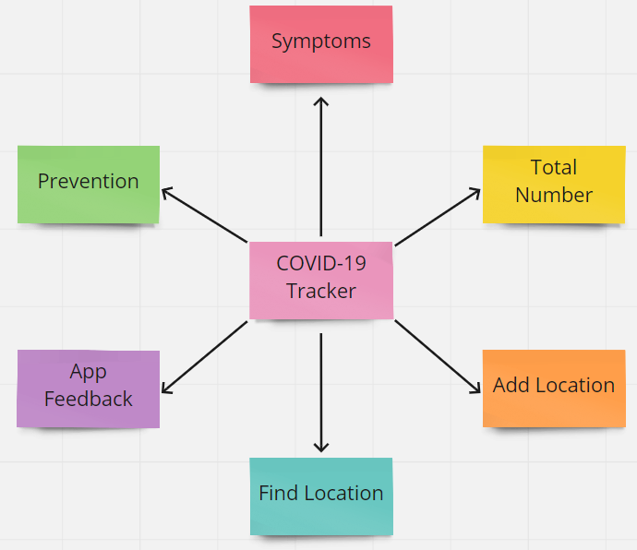
Features/Functions
Symptoms
Prevention
Total number
Find Location
Add Location
Feedback us

Slide 7
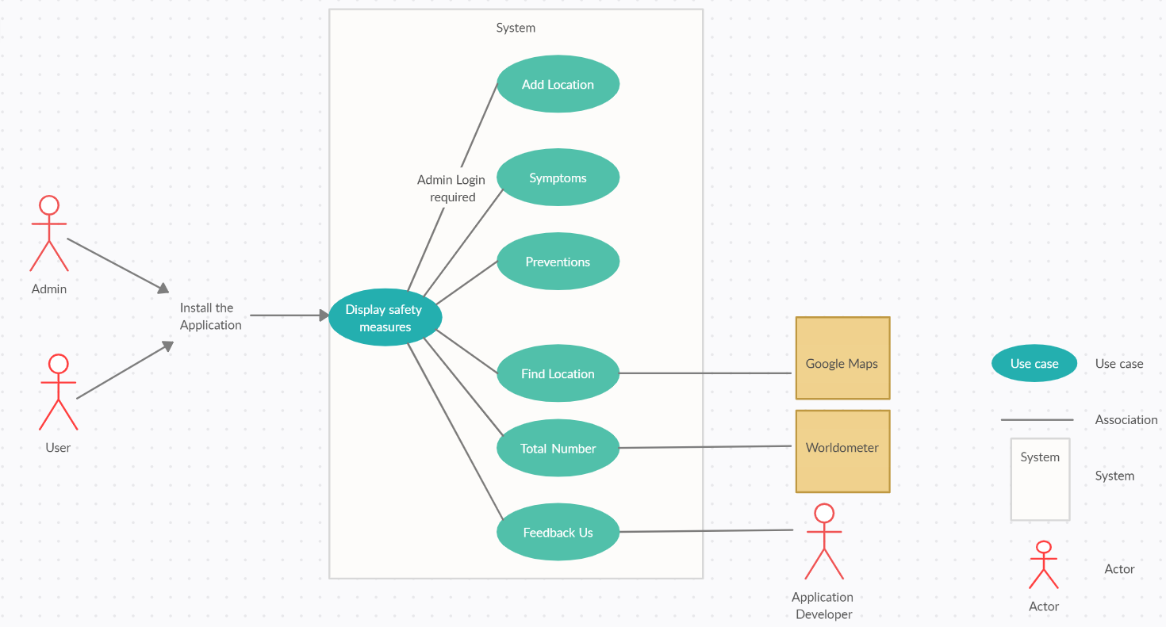
Functional relationship

Slide 8
Test Design
Bottom-up Integration Testing strategies
White box testing
Designed to test all the features listed in the previous slide

Slide 9
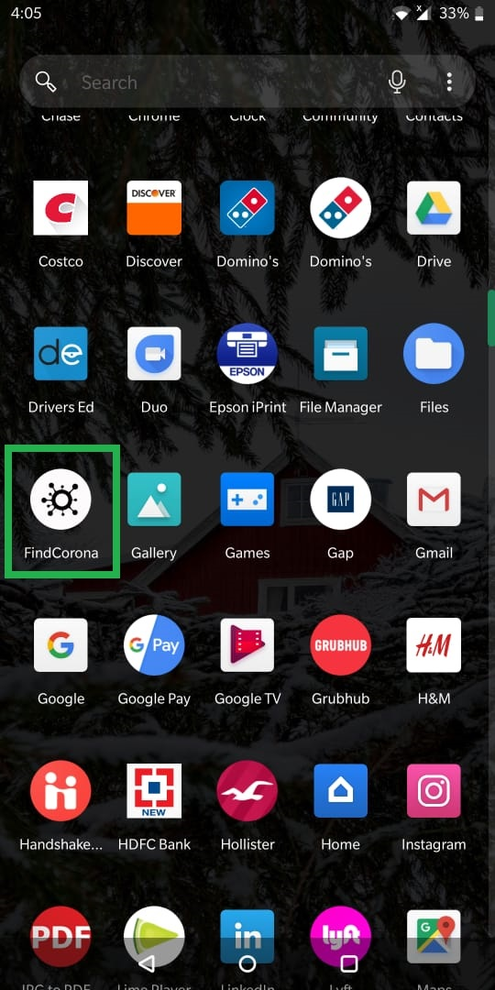
Test Cases
Step Num | Step Description | Path and Action | Test Data | Expected Results | Pass/Fail | Comments
1 | Checking if user can access the application and open it. | Download the file. |  | Application downloaded in the mobile. | PASS | Currently, we DO NOT have the application available on play store, so we just have an executable file to install the application.
2 |  | Click on the application to open it. | - | Was able to access the application. | PASS | Tested both in android & iPhone.
End | Test case to download and open the application was Passed without any issues.

Slide 10
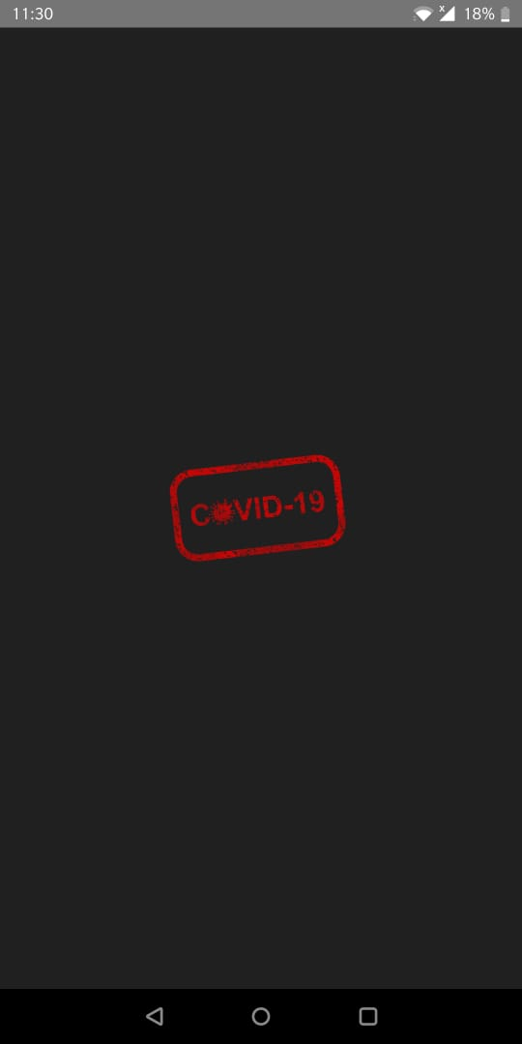
Step Num | Step Description | Path and Action | Test Data | Expected Results | Pass/Fail | Comments
1 | To test if the initial flash screen is displayed as soon as we open the application. | Click on the application to open it. | - | Application displays an initial flash screen which says COVID-19 as soon as we click on the application to open it. | PASS
End | Test case to display initial flash screen of the application was Passed without any issues.

Slide 11
Step Num | Step Description | Path and Action | Test Data | Expected Results | Pass/Fail | Comments
1 | Test case to test the initial screen of the application upon opening the application. | Click on the application to open it, which should show initial screen of safety measures. | - | Application opened in mobile. Displays initial screen - "Keep Distance: Distance means so little, when life means so much" with an image and a short message. | PASS | Since this application was developed 8 months ago it just has basic information about COVID (what we knew at that point of time)
2 | To test the second safety measure. | Swipe left to see the next safety measure. This action should move to next screen with different safety measure. | - | This left swipe moved the screen left and displayed a new screen with a different safety measure - "Wear a mask: Don’t die, please buy" with an image and a short message. | PASS
3 | To test the third safety measure. | Swipe left to see the next safety measure. This action should move to next screen with different safety measure. | - | This left swipe moved the screen left and displayed a new screen with a different safety measure - "Wash your hands: Please wash for at least 20 seconds" with a image and a short message. | PASS
4 | To test "BACK" touch button. | There will be a "BACK" touch button on second and third screen. Once BACK button is touched, it should take the user back to previous screen. | - | Upon touching the BACK button from 2nd and 3rd screen, it was taken back to 1st and 2nd screen respectively. | PASS
5 | To test "FINISH" touch button. | There is a "FINISH" touch button in the last screen of the safety measures, it should take user to main home screen of the application upon touching it. | - | Upon touching the FINISH button from the last screen, it took us to main home page of the application. | PASS
End | Test case to test the initial screen of safety measures was Passed successfully.

Slide 12
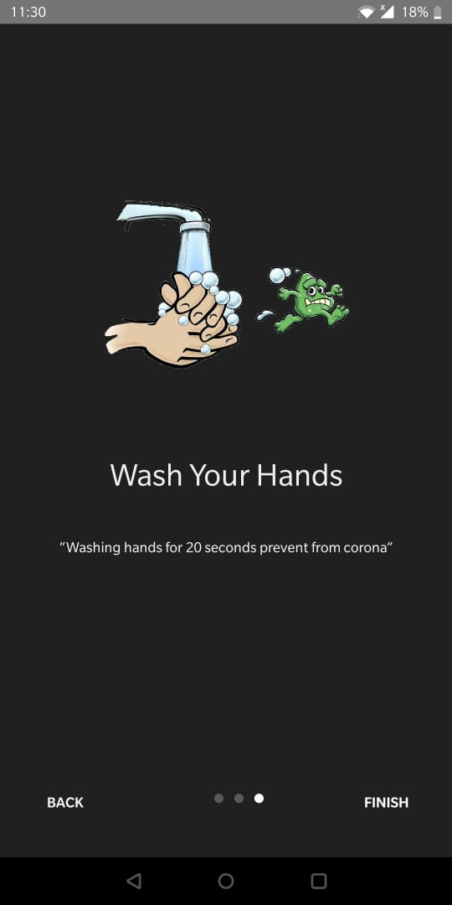
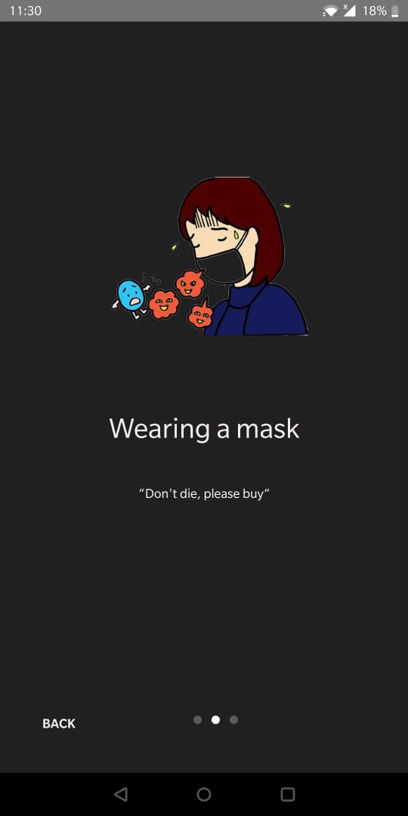
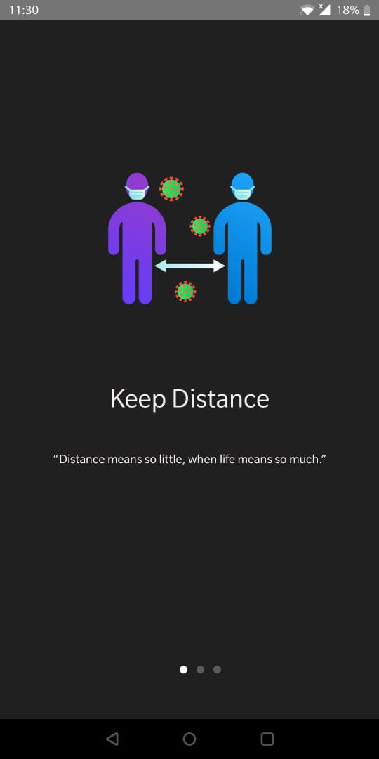

Slide 13
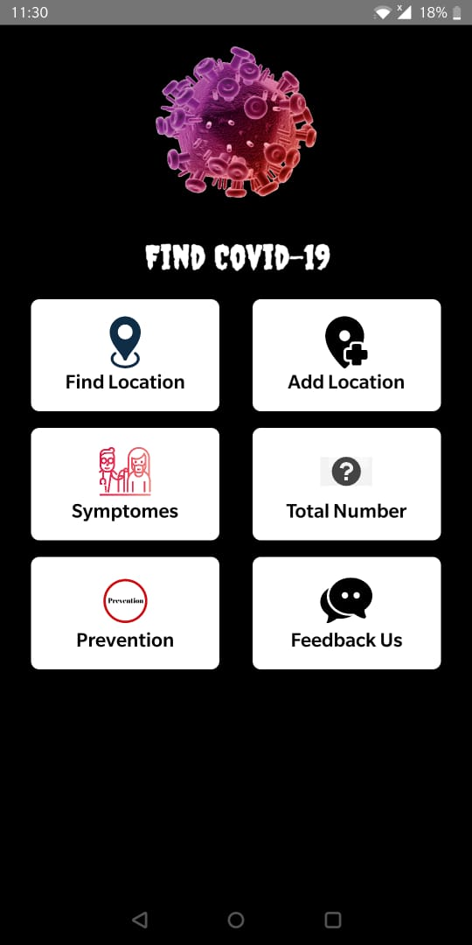
Step Num | Step Description | Path and Action | Test Data | Expected Results | Pass/Fail | Comments
1 | Test case to test the symptoms feature of the application. | Touch "Symptoms" feature available on the home screen of the application, this should take user to a new screen where all the major symptoms of COVID-19 are listed. | - | Touch on the "Symptoms" feature took us to a screen where all the symptoms of COVID-19 was listed - like Fever, Dry cough, Headache, Breathless, tired etc., with images | PASS | We have numerous symptoms at this point of time, but the application will list only 5-6 major symptoms which was highlighted last year same time.
2 | To test "BACK" touch button. | BACK touch button should navigate the user back to main home screen of the application. | - | This took us back to main home screen, tried this serval time by navigation to different screens and it worked fine. | PASS
End | Test case to test SYMPTOMS feature of the application was Passed successfully.
Step Num | Step Description | Path and Action | Test Data | Expected Results | Pass/Fail | Comments
1 | Test case to test the Prevention feature of the application. | Touch "Preventions" feature available on the home screen of the application, this should take user to a new screen where all the major Preventions of COVID-19 are listed. | - | Touch on the "Preventions" feature took us to a screen where all the preventions was listed - like stay home if sick, cover cough, cough on your elbows, clean and disinfect, avoid close contact, cover mouth and nose etc., with images. | PASS
2 | To test "BACK" touch button. | BACK touch button should navigate the user back to main home screen of the application. | - | This took us back to main home screen. | PASS
End | Test case to test PREVENTION feature of the application was Passed successfully.

Slide 14
Step Num | Step Description | Path and Action | Test Data | Expected Results | Pass/Fail | Comments
01. | Test case to test admin login feature. | Touch "Add location" feature on the home screen of the application, this should take user to admin login screen (we have restricted adding location by all users at this point of time). | - | "Add location" touch button took us to admin login screen. | PASS
02. | To test admin login for various inputs. | Leave both email and password blanks and try to login. | - | It doesn’t work every time, sometime application gets crashed and doesn’t show any pop-up text. | FAIL
03. |  | Enter only email and leaving the password blanks. | - | If email does not contain any "@xx.com", instead of throwing a pop-up text "email incorrect", application redirect user to main screen. | FAIL
04. |  | Enter only password and leave email blanks. | - | Received a pop-up telling- "Please enter email to login". | PASS
05. |  | Enter incorrect email and password. | - | Received a pop-up telling- “Authentication Failed". | PASS
06. |  | Enter correct email and password. | - | Was able to login successfully. | PASS
End | Test case to test ADMIN LOGIN feature was FAILED.

Slide 15
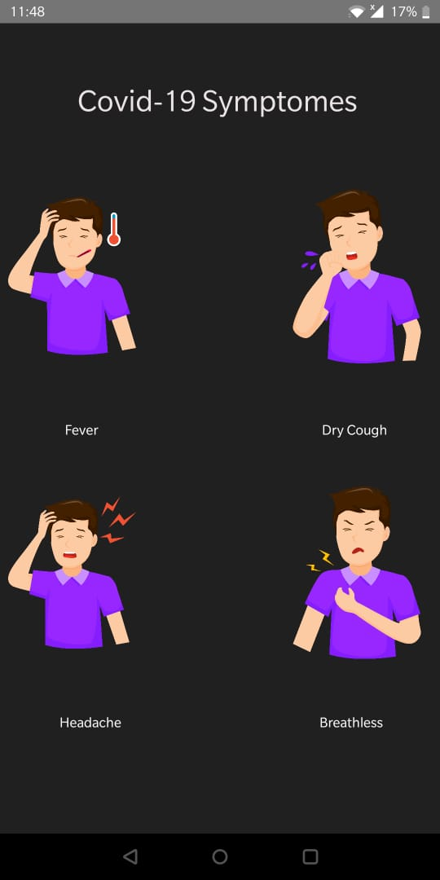
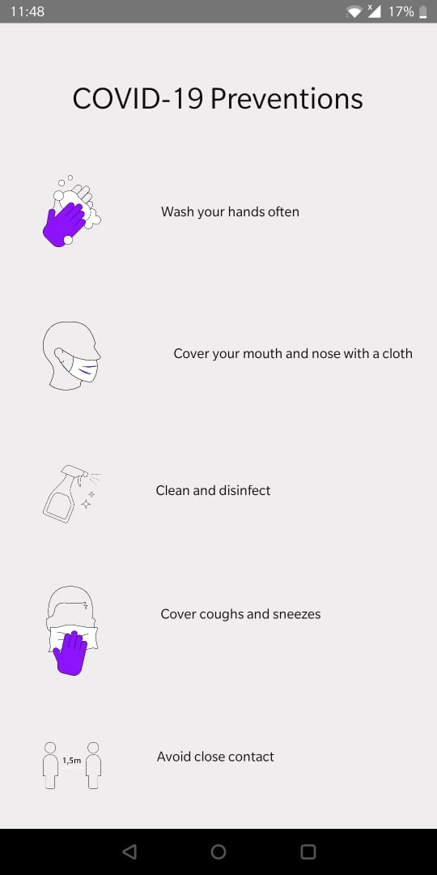
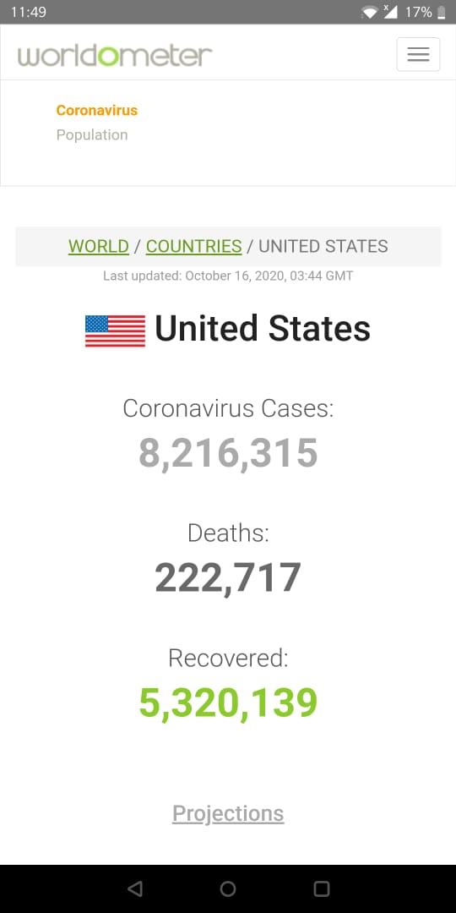
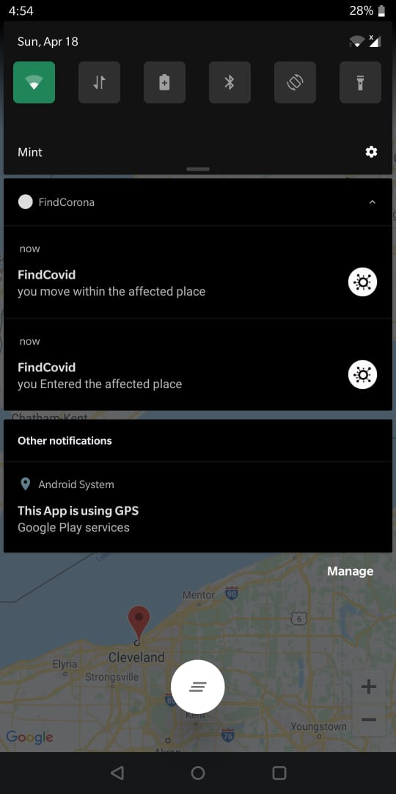

Slide 16
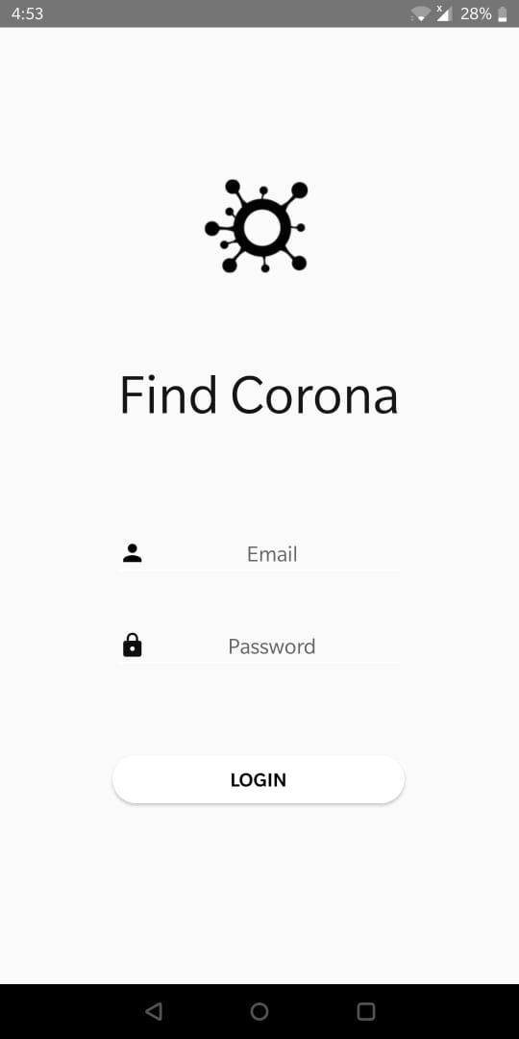
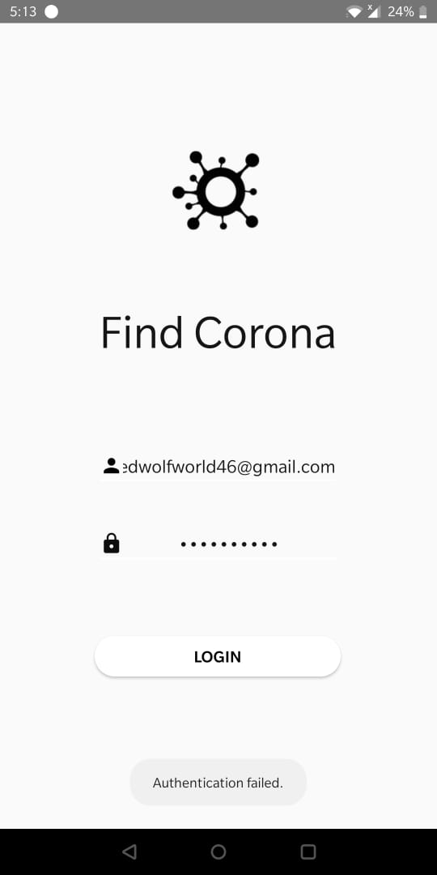
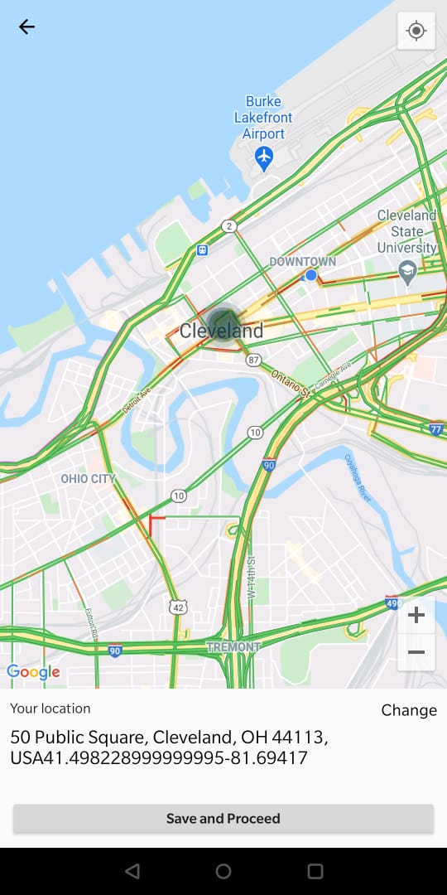

Slide 17
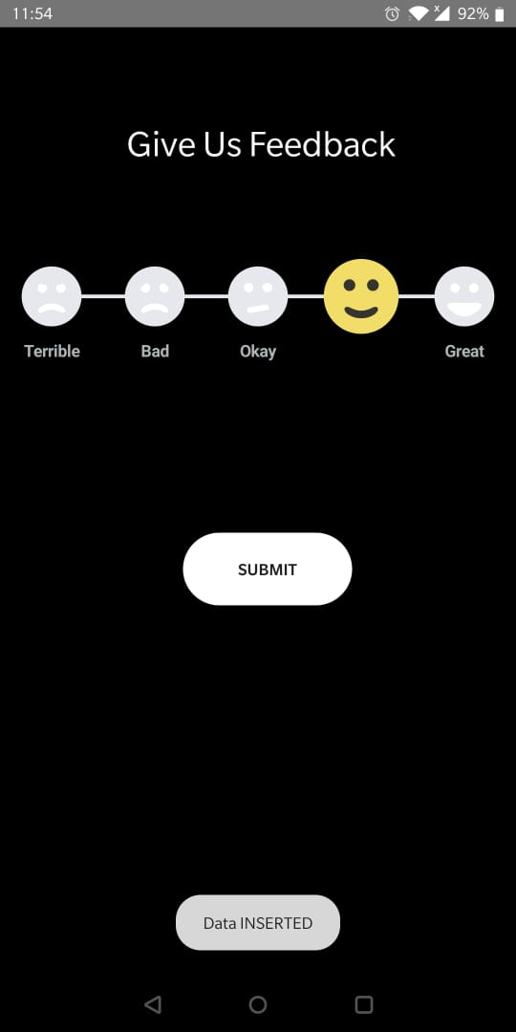
Step Num | Step Description | Path and Action | Test Data | Expected Results | Pass/Fail | Comments
1 | Test case to test the "Feedback stored in the database" feature of the application | Touch "Feedback Us" feature available on the home screen of the application, after touching it should redirect it to a new screen from which user has to select a rating and then click on submit button. After Submitting the feedback, it should show in Firebase Database. | - | User feedback was there in the Firebase Database in the form of point, scaling from 0-5. | PASS
End | Test case to test FIREBASE DATABASE feature of the application was Passed successfully.

Slide 18
Test Results
TEST CASE ID | TEST CASE DESCRIPTION |  | PASS/FAIL | COMMENTS
1 | Download application and opening |  | PASS
2 | Flash screen of the application |  | PASS
3 | Initial safety measures screen |  | PASS
4 | Home screen features display |  | PASS
5 | Symptom feature |  | PASS
6 | Prevention feature |  | PASS
7 | Total number feature |  | PASS
8 | Find location feature |  | PASS
9 | Admin login | Normal login with correct credentials | PASS
10 |  | Empty fileds login | FAIL | Application crashes for some reason instead of throwing a pop-up message
11 |  | Email only login | PASS
 |  | Invalid email login | FAIL | Handled this condition to check .com but does not work
12 |  | Password only login | PASS
13 |  | Incorrect email & Password login | PASS
14 | Add location feature |  | PASS
15 | Feedback us feature |  | PASS

Slide 19
Test Results Summary
Test case planned | 15
Test case executed | 15
Test case passed | 13
Test case failed | 2

Slide 20
Dependencies and Limitation
Dependent on Worldometer.
Total number of user cannot exceed 100.

Slide 21
Conclusion
Application developed during initial days of corona.
Provides basic information about COVID-19.
Gives notification to user when they enter the affected zone.
This is a very small contribution from our end to keep users safe from COVID-19 which can help in stop spreading the virus.

Slide 22

Questions??

Slide 23
Thank you!!

